Slide 1








ONLINE PATIENT MANAGEMENT SYSTEM
Azizul Islam Nayem | [011201262]
A.Wahab | [011193058]

Slide 2

BREAKDOWN
Finished Things
Topics finalization.
Prepare ERD.
Prepare Relational Schema.
Creating Database.
Creating Tables.
Creating Columns.
Putting Dummy Data.
Creating PHP files for each table.

Slide 3
FEATURES
FEATURES:
Storing patient’s details.
Finding patient’s diseases.
Collecting patient’s history.
FEATURES:
Blood details.
Method of payments.
Test details, process and result..
Overall payment history.
FEATURES:
Storing doctor’s details.
Doctor’s qualifications.
Doctor’s chamber and pa.
FEATURES:
Tracking pa’s details.
Chamber’s details.
Payment procedure.

Slide 4
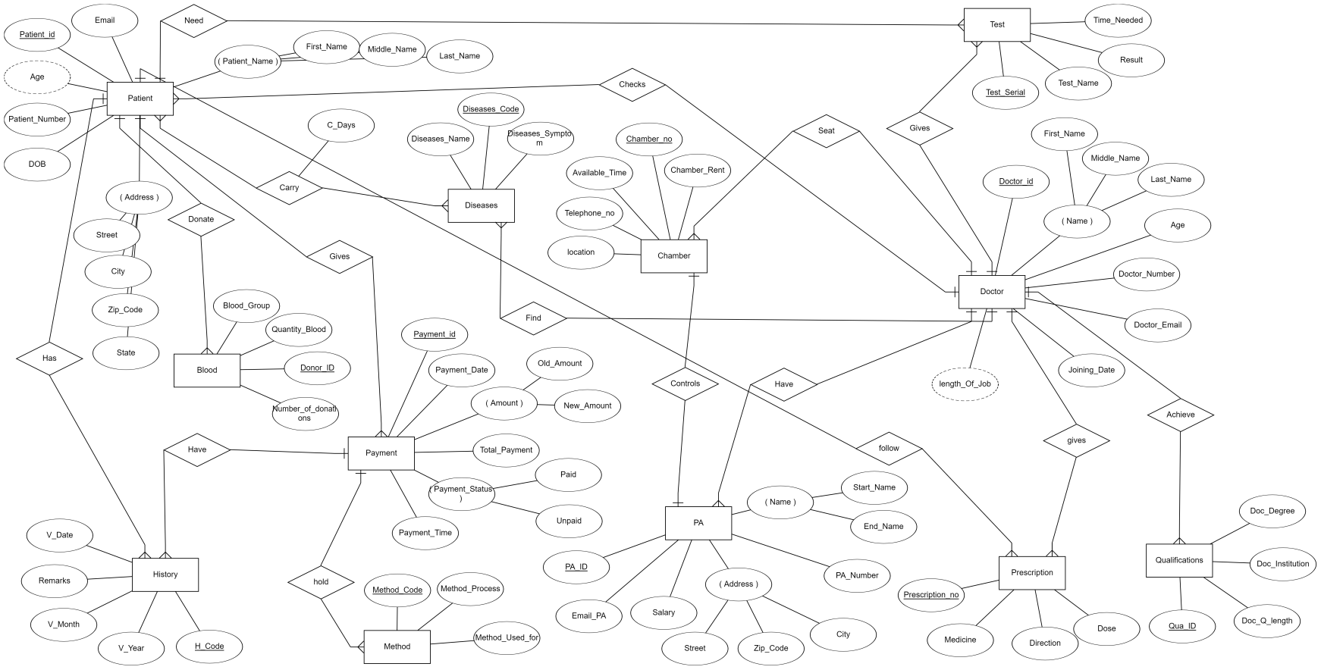
ENTITIES
ERD

Slide 5
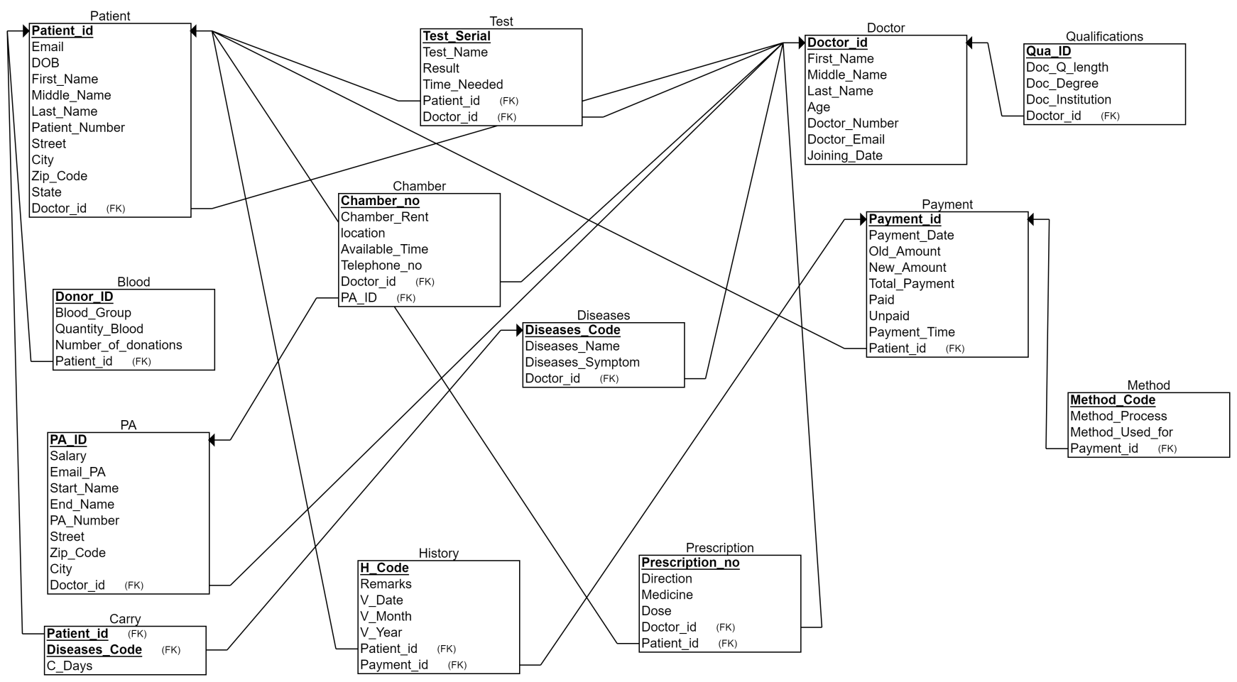
SCHEMA

Slide 6
BREAKDOWN
To-do List
CRUD Operations.
Overall design of the website.
WEEK - 01
Editing using PHP.
SELECT query usage INSERT query usage.
UPDATE query usage. DELETE query usage.
WEEK - 02
Using advanced queries in WebPages.
JOIN query usage. AGGREGATE query usage.
SUBQUERY usage
WEEK - 03

Slide 7
THANK YOU

